Slide 1

Chapter 16 – extra

Slide 2
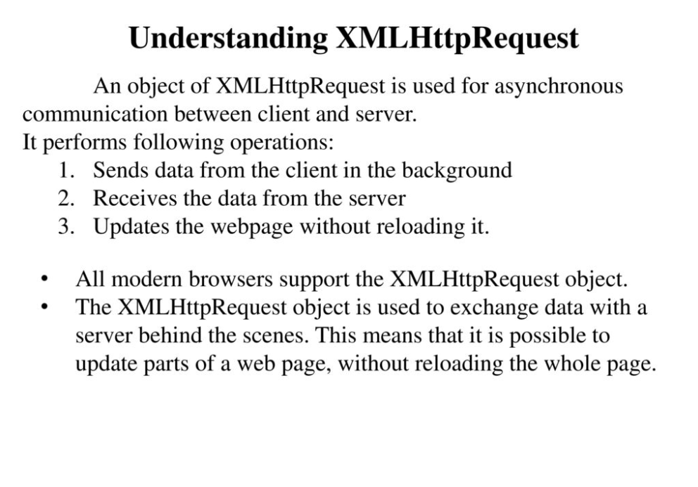
Source: https://slideplayer.com/slide/12988549/

Slide 3
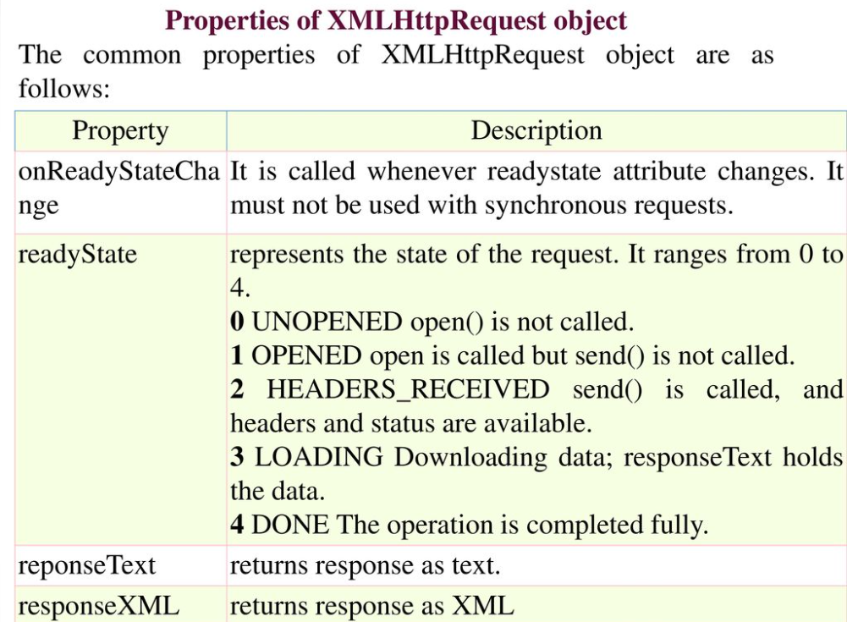

Slide 4
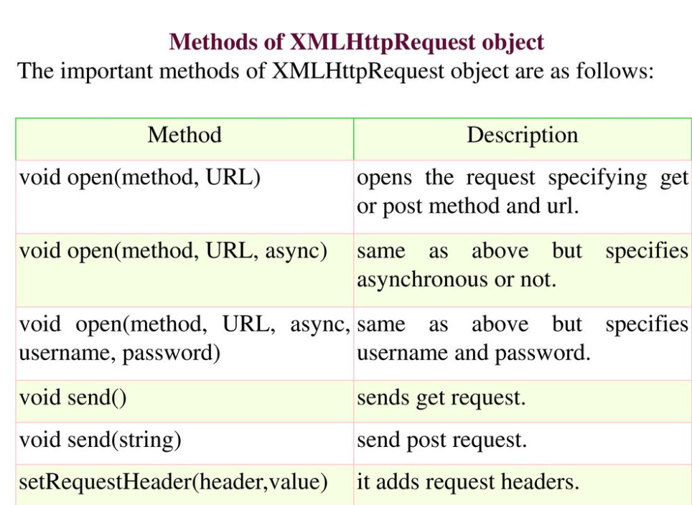

Slide 5
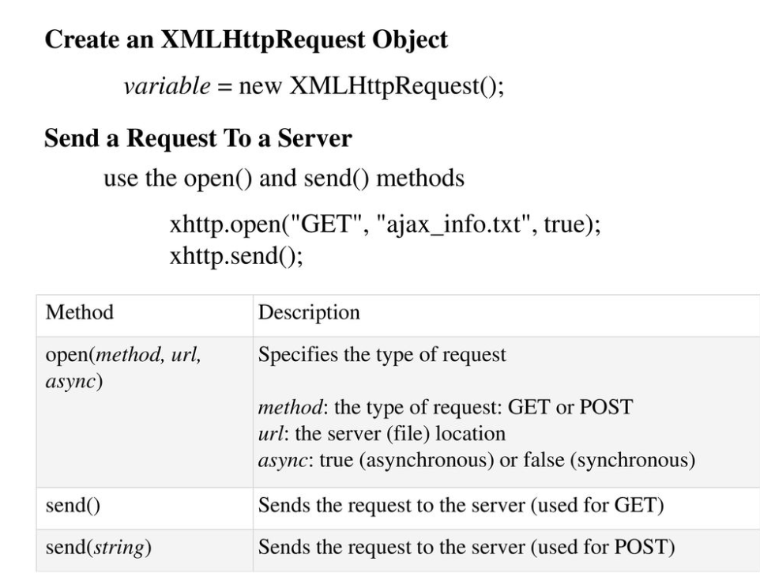

Slide 6
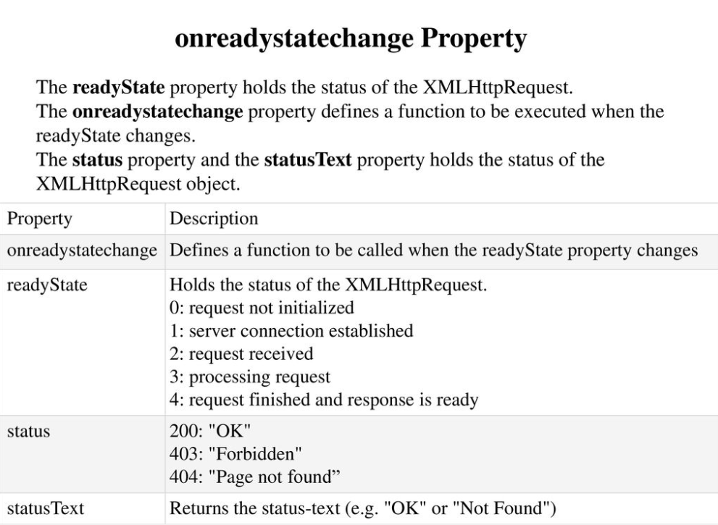

Slide 7
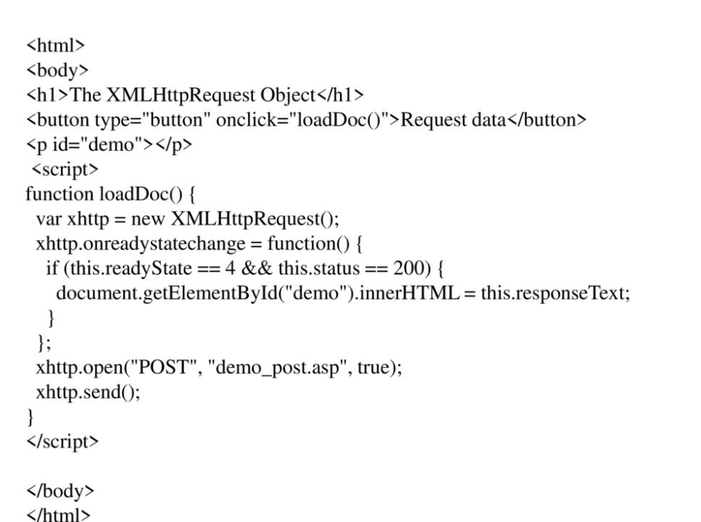

Slide 8
XML
XML stands for Extensible Markup Language. It is a text-based markup language derived from Standard Generalized Markup Language (SGML).
XML tags identify the data and are used to store and organize the data, rather than specifying how to display it like HTML tags, which are used to display the data.
There are three important characteristics of XML that make it useful in a variety of systems and solutions:
XML is extensible: XML allows you to create your own self-descriptive tags or language, that suits your application.
XML carries the data, does not present it: XML allows you to store the data irrespective of how it will be presented.
XML is a public standard: XML was developed by an organization called the World Wide Web Consortium (W3C) and is available as an open standard.

Slide 9
XML
XML can work behind the scene to simplify the creation of HTML documents for large web sites.
XML can be used to exchange the information between organizations and systems.
XML can be used for offloading and reloading of databases.
XML can be used to store and arrange the data, which can customize your data handling needs.
XML can easily be merged with style sheets to create almost any desired output.
Virtually, any type of data can be expressed as an XML document.

Slide 10
XML Syntax
<?xml version="1.0"?>
<contact-info>
<name>Jennifer Doe</name>
<company>BCBS</company>
<phone>(011)123-4567</phone>
</contact-info>
You can notice, there are two kinds of information in the above example:
Markup, like <contact-info>
The text, or the character data, BCBS and (011)123-4567

Slide 11
Syntax Rules for XML Declaration
The XML declaration is case sensitive and must begin with "<?xml>" where "xml" is written in lower-case.
If the document contains XML declaration, then it strictly needs to be the first statement of the XML document.

Slide 12
Syntax for tags and elements (XHTML Rules)
Elements must be container elements or empty.
<element> … </element>
<element/>
Nested elements are last to open, first to close.
Each XML document may only have one root element.
Elements are case sensitive.
<name> … </Name> ← Incorrect Syntax

Slide 13
XML Text
The names of XML-elements and XML-attributes are case-sensitive, which means the name of start and end elements need to be written in the same case. To avoid character encoding problems, all XML files should be saved as Unicode UTF-8 or UTF-16 files.
Whitespace characters like blanks, tabs and line-breaks between XML-elements and between the XML-attributes will be ignored.
Some characters are reserved by the XML syntax itself. Hence, they cannot be used directly. To use them, some replacement-entities are used, which are listed below:
Not Allowed Character Replacement Entity Character Description
< &lt; less than
> &gt; greater than
& &amp; ampersand
' &apos; apostrophe
" &quot; quotation mark

Slide 14
Open each type of file then parse thru JSON and XML Use solely in the final project

